Slide 1
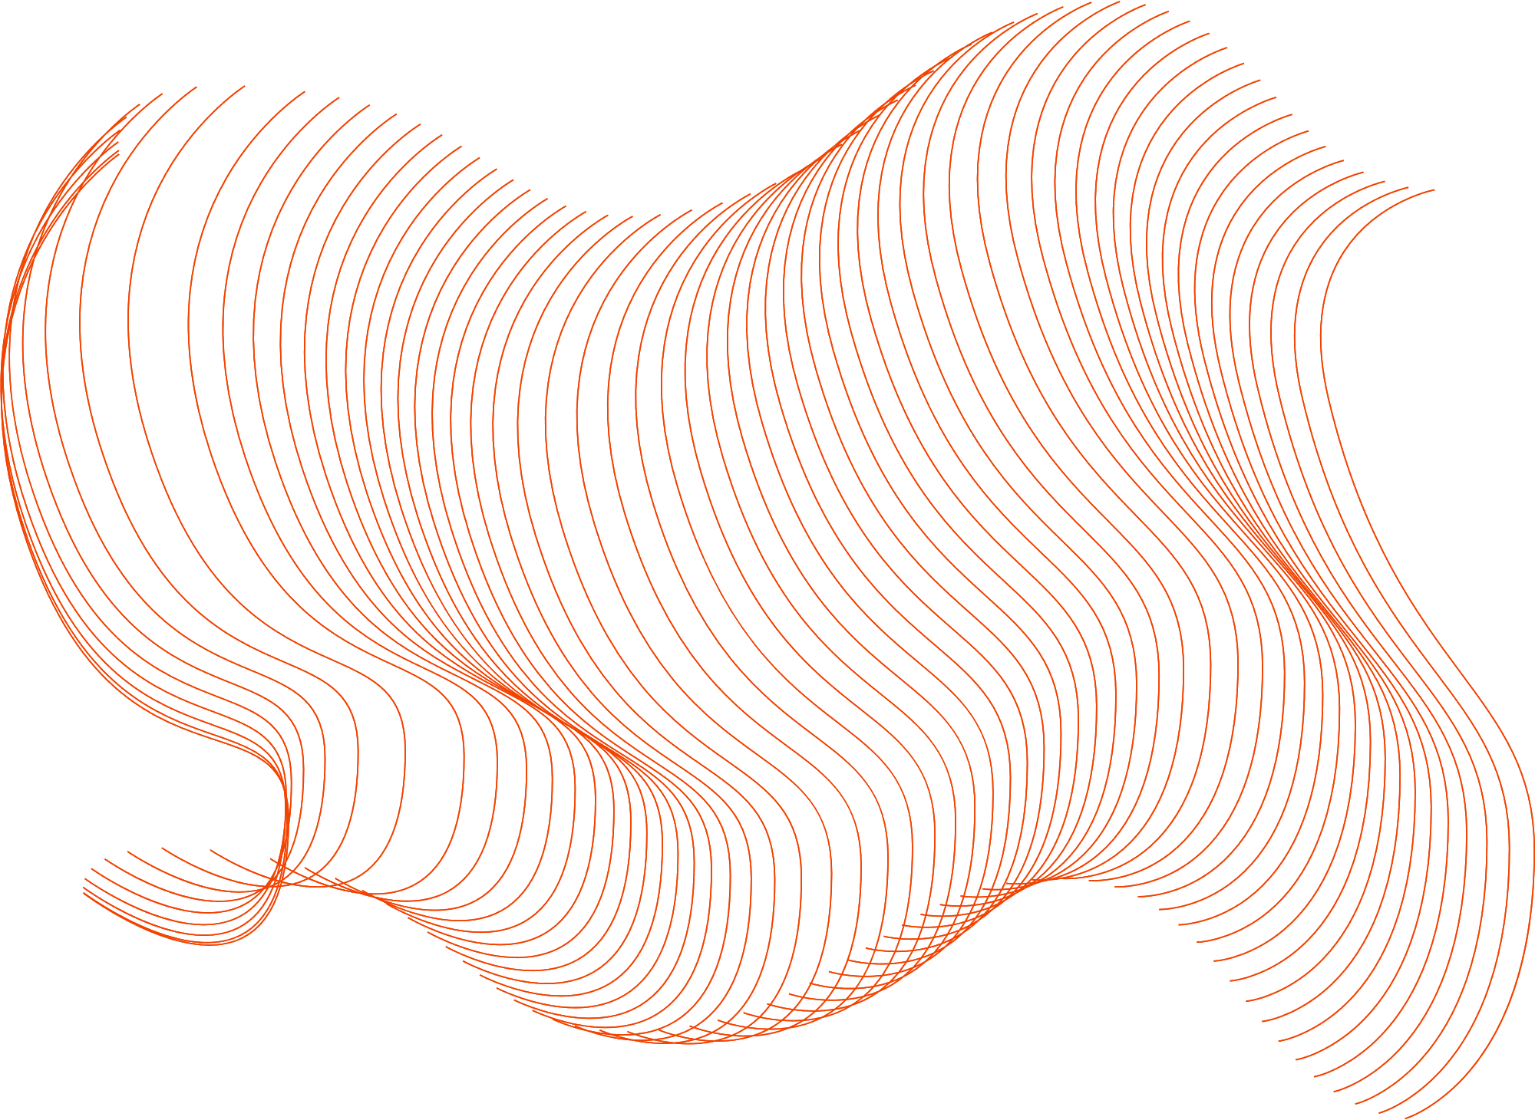

IT4110E - Scientific Computing
Diffusion-Limited Aggregation
Group 9
Diffusion-Limited Aggregation

Slide 2
IT4110E - Scientific Computing
Group Members
Fullname | Student's ID
Trần Đức Nam | 20215228
Nguyễn Trọng Huy | 20210451
Nguyễn Chính Minh | 20215224
Trịnh Giang Nam | 20215229
Diffusion-Limited Aggregation

Slide 3




Introduction
Scientific Computing
- Diffusion-Limited Aggregation (DLA)
- Application of DLA
- Problem description
Theory
- Theory
- SOR Method
- Application to DLA problem
Table of Contents
Installation
- Data Modeling
- Program Design
- Simulation in MATLAB
Diffusion-Limited Aggregation
Results & Conclusion

Slide 4
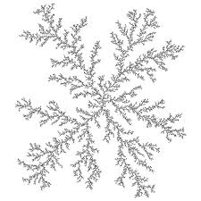
Diffusion-Limited Aggregation
Introduction
1. What is Diffusion-Limited Aggregation (DLA) ?
DLA is a process that simulates the random scalar growth of particles in a diffusive manner
2. Application of DLA
DLA has been used in various field including physics, chemistry, computer science....
DLA is a model for non-equilibrium growth
DLA can be a model for a Bacillus subtilis bacteria colony in a petri dish

Slide 5
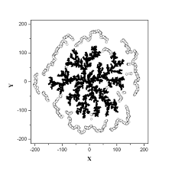
Diffusion-Limited Aggregation
Introduction
3. Problem Description
The process of simulating growth of virus-producing individual
The environment contains food and the virus will not stop eating food and growing

Slide 6
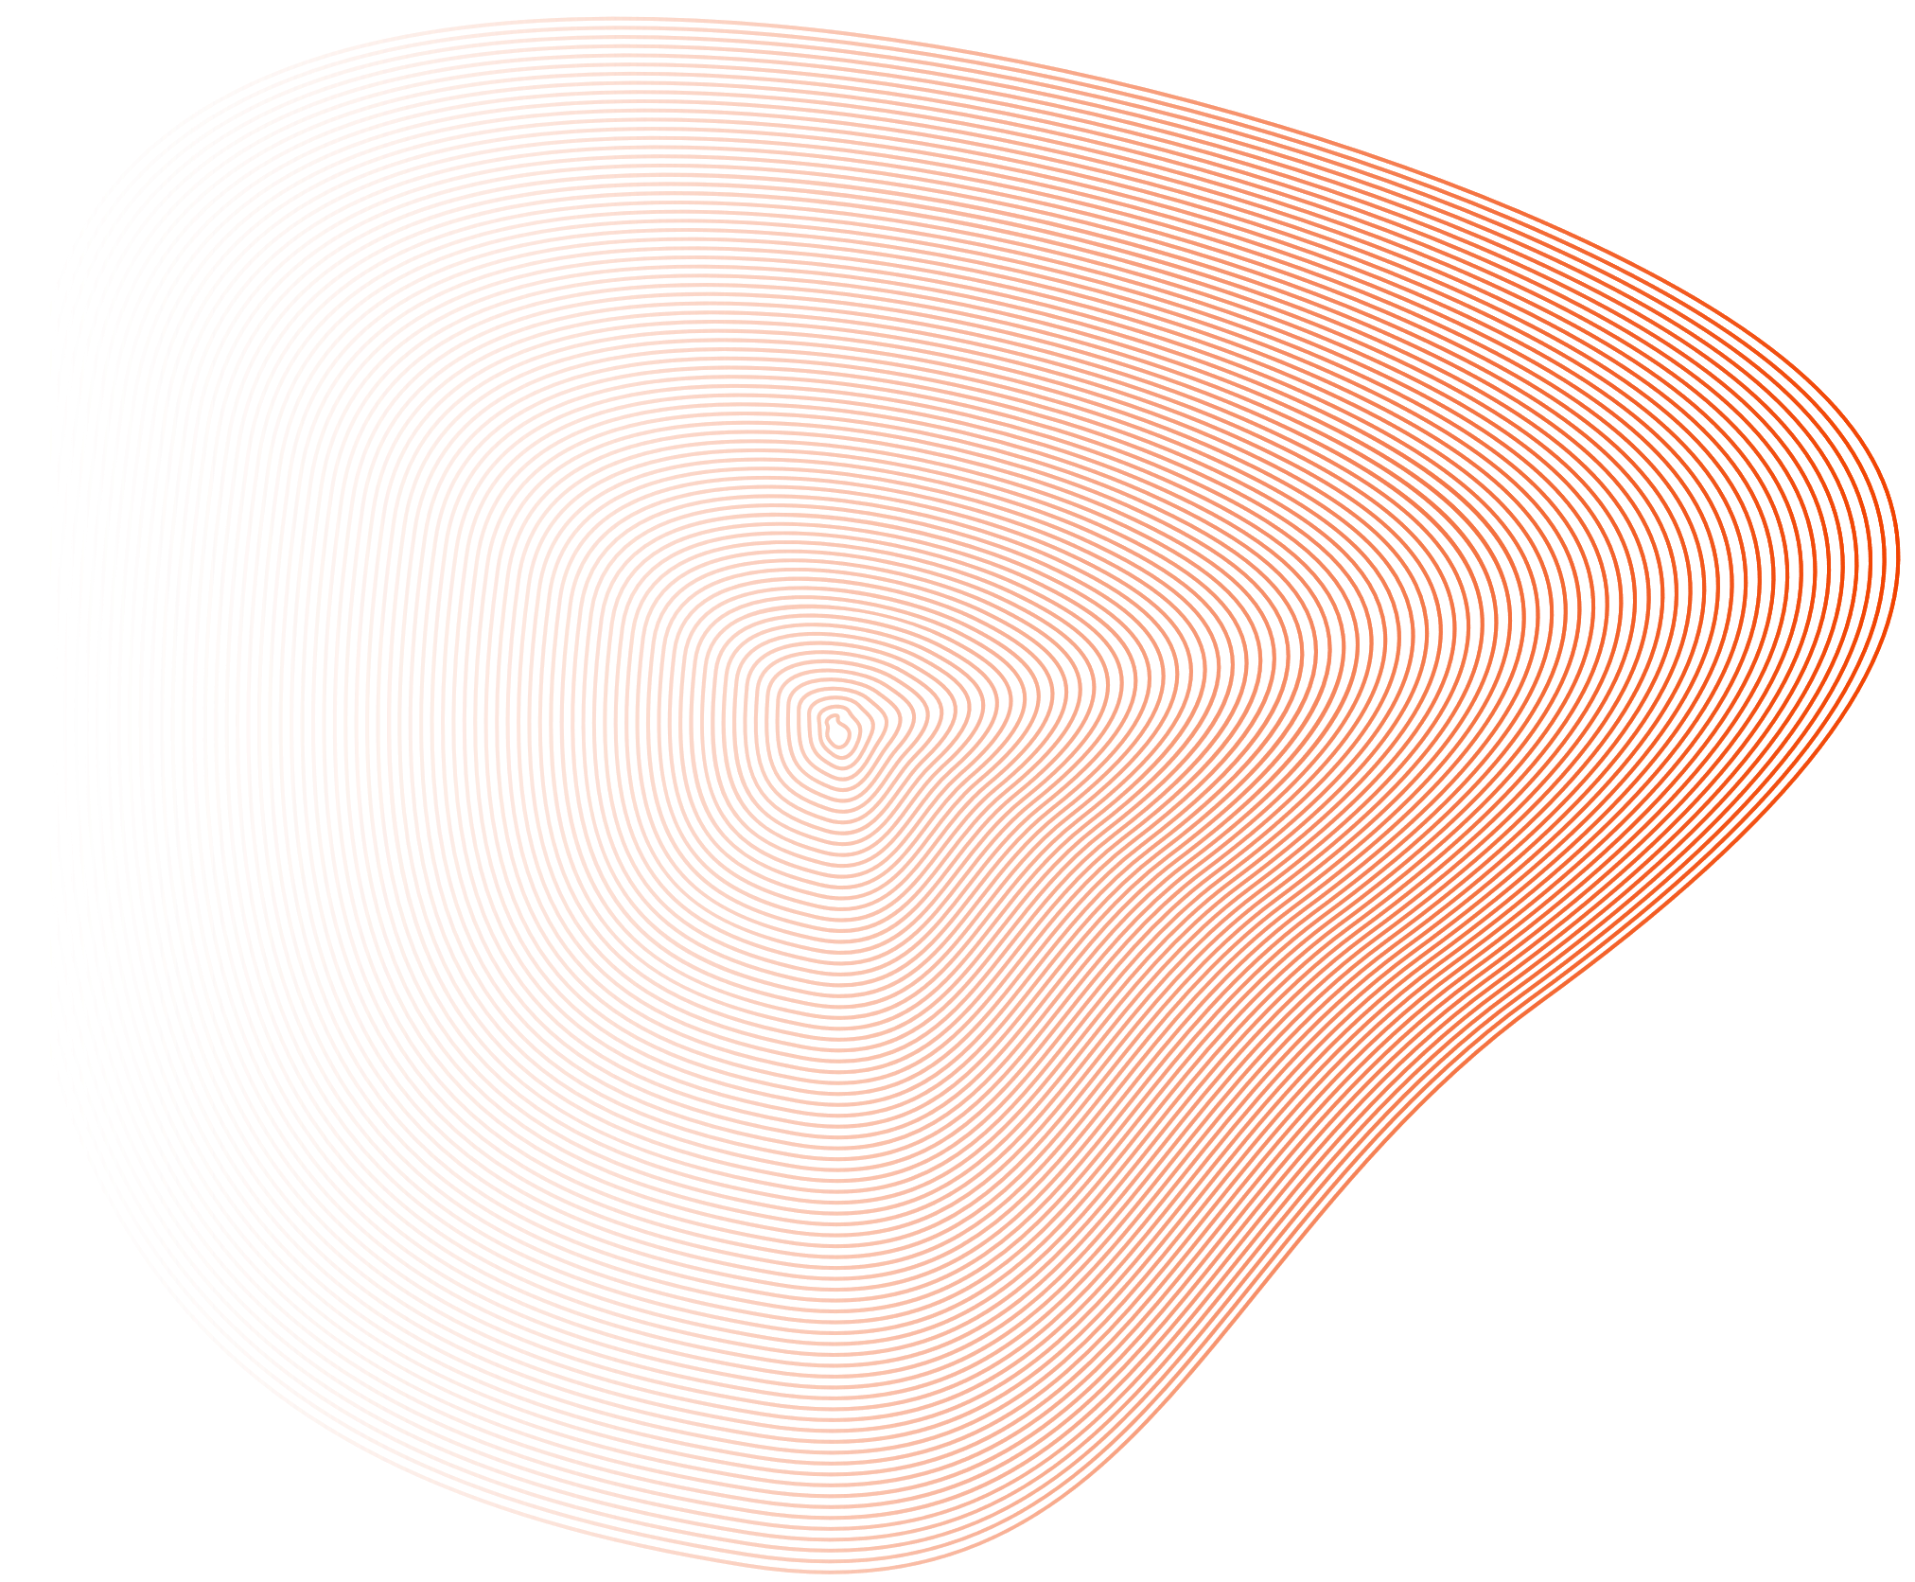
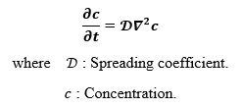
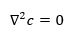
Time-independent propagation equation
Diffusion-Limited Aggregation
Theory
1. Theory
Bacteria will grow from a single cell.
Food concentration is constantly changing.
We will use the time-independent propagation equation for food concentration determination
Derivative of concentration wrt time is zero

Slide 7
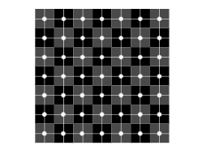
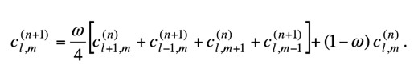
Red-Black Ordering
Diffusion-Limited Aggregation
Theory
2. Successive Over Relaxation (SOR) Method
Red-black ordering means that we first update all red points in parallel
Within each domain updating can be donw with the row-wise ordering scheme
Formula of SOR iterative method
By mixing the Gauss-Seidel result with the current, we have the formula of SOR iterative method
where w is the correction parameter, (1 < w < 2) and in this case, we choose w = 1.9

Slide 8
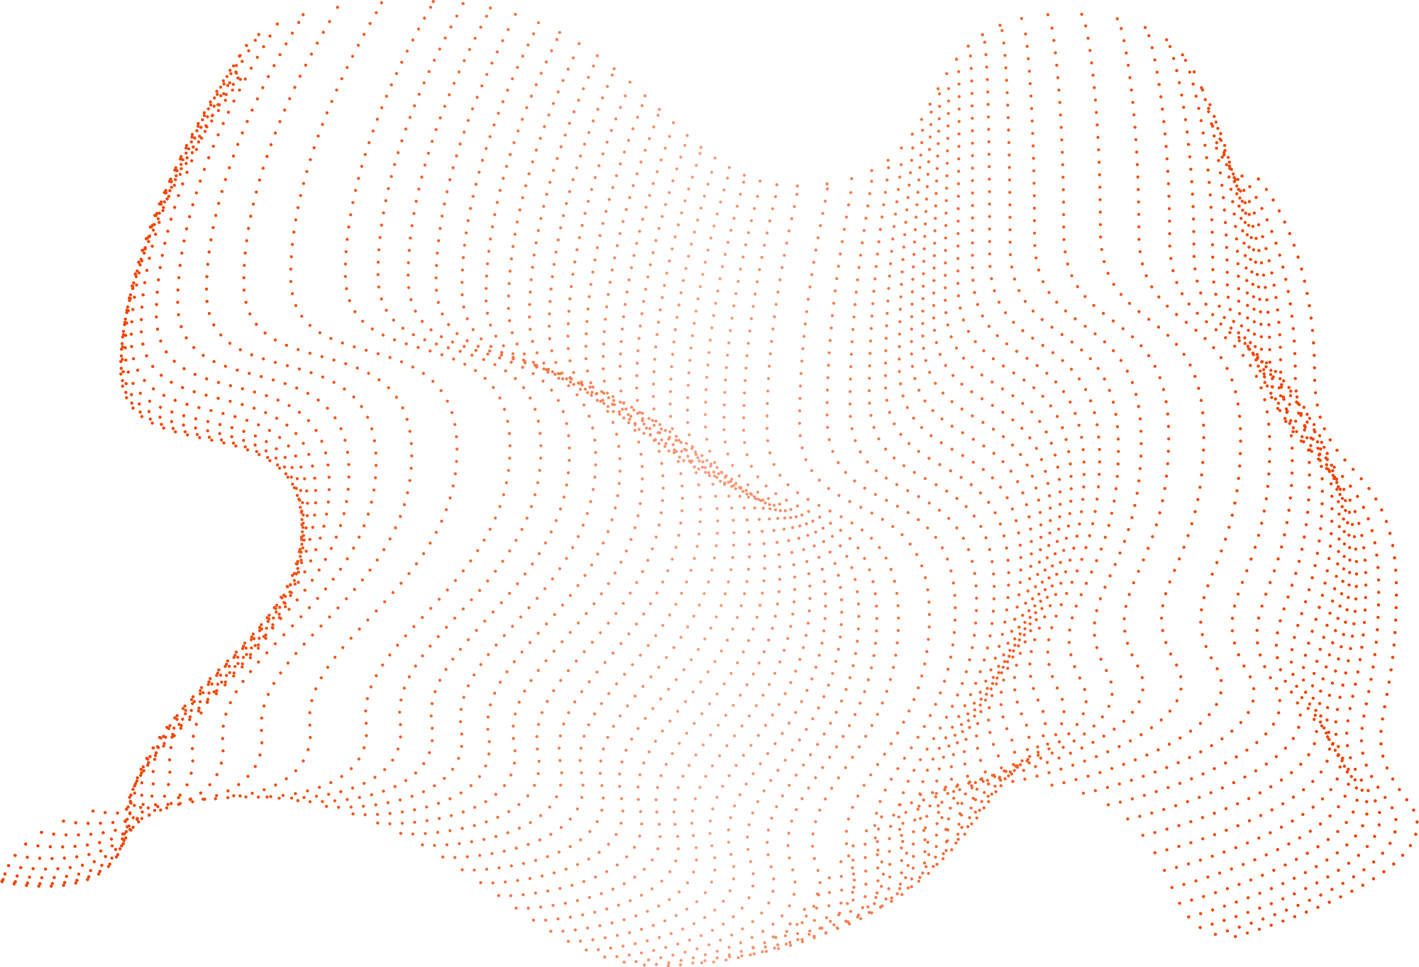
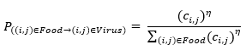
Diffusion-Limited Aggregation
Theory
Probability of the virus developing
3. Application to DLA problem
The basic algorithm to simulate DLA process:
Step 1: Solve the propagation equation
Step 2: Let the virus reproduce
Step 3: Go back to step 1
The exponent η determines the shape of the virus reservoir (usually from 0.5 to 2)

Slide 9

Diffusion-Limited Aggregation
Installation
The programming is installed on Cpp language, GNU compiler via Visual Studio tool on windows environment.
INSTALLATION

Slide 10

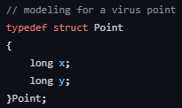

Installation
Diffusion-Limited Aggregation
1. Data Modeling
Array virus[ ]
Virus point is modeled on Cpp
is the list of appeared virus
Variable nVirus
stores current number of viruses
x and y are coordinate of row and column
Array candidate[ ]
is the list of candidates can be affected by the virus
Variable nCandidate
stores the number of candidates
Array c[ ][ ]
represents the remaining food in the area
Array grow[ ][ ]
marks position of viruses
Array chance[ ]
holds the probabilities of candidates

Slide 11
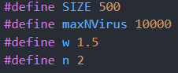
Installation
Diffusion-Limited Aggregation
2. Program Design (Input/Output Data)
Input Data: Position of the first virus
Output Data: Write matrix of the virus to "result.txt"

Slide 12
Installation
Diffusion-Limited Aggregation
2. Program Design (Procedure)
addVirus(u,v,x)
init()
Marks the presense of a virus at cell (u,v) and add to the list
Initialize the value arrays
sor()
eat()
computeProbability()
Use SOR method to calculate the matrix c[ ][ ]
Mark the value c[i][j] having virus to 0
Calculate probability of each candidate.
solve()
main()
growth()
Loop until the desired number of viruses is reached
Read data, call solve function, print the data.
Generate random virus

Slide 13
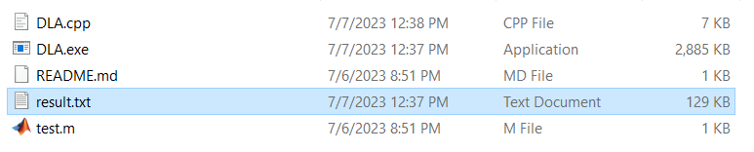
Installation
Diffusion-Limited Aggregation
3. Simulation in MATLAB
Store output file in "result.txt"

Slide 14
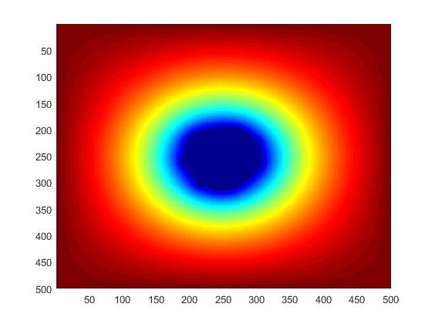
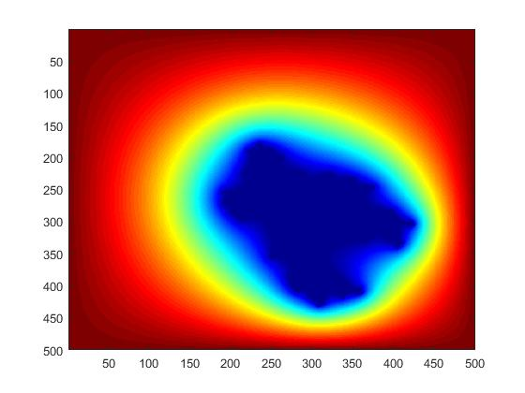
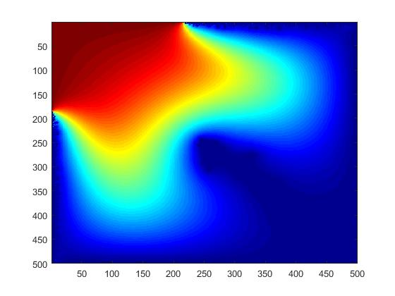
Diffusion-Limited Aggregation
Results
Testcase 1: η = 0
Testcase 2: η = 1
We set:
Size of matrix: 500x500
Maximum virus: 10000
Omega: 1.5
The virus is in the center of the board
Testcase 3: η = 2

Slide 15
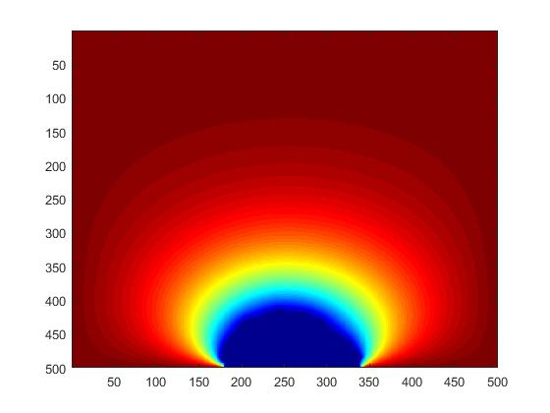
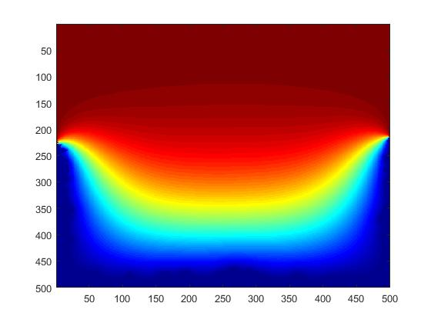
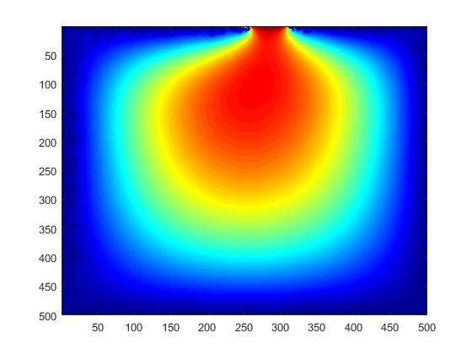
Diffusion-Limited Aggregation
Results
Testcase 1: η = 0
Testcase 2: η = 1
We set:
Size of matrix: 500x500
Maximum virus: 10000
Omega: 1.5
The virus is in the center of bottom of the board
Testcase 3: η = 2

Slide 16
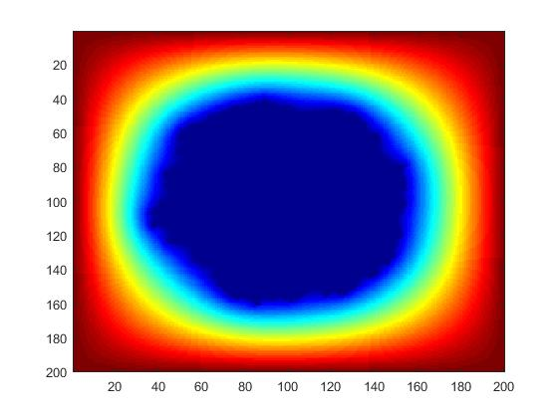
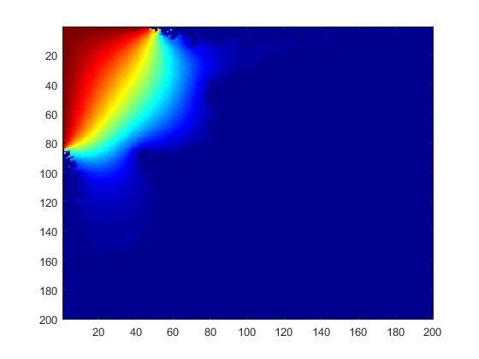
Diffusion-Limited Aggregation
Results
We set:
Size of matrix: 200x200
Testcase 1: η = 0
Maximum virus: 10000
Omega: 1.5
The virus is in the center of the board
Testcase 2: η = 1

Slide 17

Diffusion-Limited Aggregation
Comments
The exponent η influences the development of the virus
For η = 0, the probability of new virus appearance is the same for all position.
For η = 1, the probability of a new virus appearance is proportional to the available food concentration at that location.
For η = 2, the probability is proportional to the square of the available food concentration
Comments & Conclusion
Conclusion
The principles and algorithms of the DLA simulation method using SOR Method
The direct test results as well as some evaluations.
COMMENTS & CONCLUSION

Slide 18
Diffusion-Limited Aggregation
Thank you
QUAY LẠI TRANG CHƯƠNG TRÌNH

